Slide 1
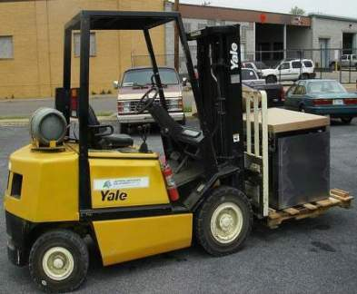
Safe Operation of Forklifts and Other Powered Industrial Trucks
The following topics will be covered:
Forklift-related fatalities and injuries
Types of forklifts
How a forklift operates
Hazards of forklift operation
How to use forklifts safely
Wikimedia commons
Notes:
This training will mainly cover standard forklifts – similar to one in the photo on this slide.

Slide 2
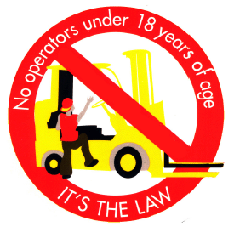
Safe Operation of Forklifts and Other Powered Industrial Trucks
You must be 18 years or older to operate a forklift
Notes:
First thing – It is against the law for anyone under 18 to operate a forklift. This is both a Washington State and federal law.

Slide 3
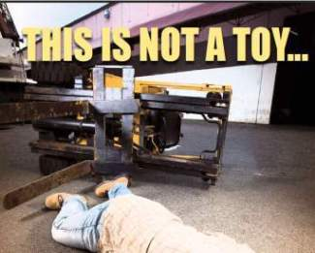
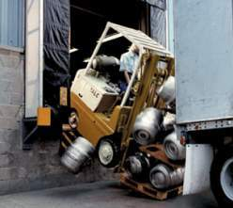
Safe Operation of Forklifts and Other Powered Industrial Trucks
The risk of ignoring forklift safety
Forklifts are extremely useful in a variety of workplaces, but there is great risk of property damage, injury or death if you:
Are not trained on forklift safety
Are not familiar with the specific forklift vehicle
Operate the forklift in an unsafe manner
Operate a forklift with a defect or missing parts
Source: WorksafeBC
Source: RiteHite Doors
Notes:
Because the cause of so many forklift accidents is lack of proper training, this training is required by L & I regulations for any person who will using a forklift.

Slide 4
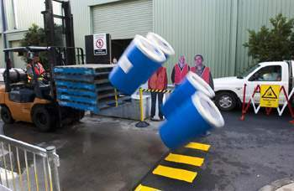
Forklift accident statistics
Safe Operation of Forklifts and Other Powered Industrial Trucks
85 to 100 workers in the U.S. are killed every year in forklift accidents.
Approximately 35,000 serious injuries and 62,000 non-serious injuries involving forklifts occur in the United States every year. OSHA estimates 11% of all forklifts are involved in accidents every year.
Fatal Accident Type | %
Crushed by vehicle tipping over | 42%
Crushed between vehicle and a surface | 25%
Crushed between two vehicles | 11%
Struck or run over by a forklift | 10%
Struck by falling material | 8%
Fall from platform on the forks | 4%
Source: Monash University – Australia
View Fatality examples
Notes:
This slide shows that forklifts can be dangerous. The link to fatalities investigated by federal OSHA are about 10 years old, but similar accidents still occur.

Slide 5
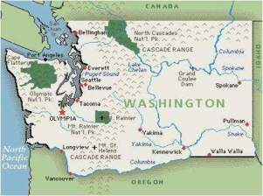
Safe Operation of Forklifts and Other Powered Industrial Trucks
Washington State forklift accidents & citations
The 5 most common citations by L & I safety inspectors involving forklifts in last three years (2007 – 2009) were as follows:
Lack of training
No seatbelt or not using seatbelt
No inspection of the forklift for defects
Modification of forklift without manufacturer’s approval
No nameplate or unreadable nameplate
13 employees were killed in forklift-related accidents from 2000 to 2009
1000+ employees were seriously injured (had to take time off from work to recover) in forklift-related accidents in the years 2006, 2007 & 2008
Notes:
As you can see from these statistics, forklifts injure or even kill workers in our State and the reason is often due to lack of proper training. DOSH safety inspectors routinely ask if forklift drivers have had training during their workplace inspections and will cite a company if they don’t. So, be sure to take this training seriously and get further hands-on training on the specific forklift you will be operating after you have completed this online course.

Slide 6
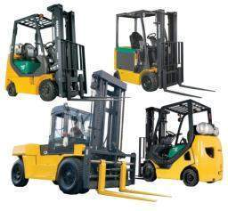
What is a powered industrial truck (P.I.T.)?
Definition: A powered vehicle used to carry, push, pull, lift, stack or tier materials.
Another way of describing powered industrial trucks is that they include standard forklifts and special use forklifts and industrial vehicles.
They are all regulated by the DOSH P.I.T. regulations – WAC 296 - 863
The Industrial Truck Association list seven classes of PITs:
Class 1 Electric Truck Class 5 Truck
Class 2 Electric Truck Class 6 Industrial Tractor Truck
Class 3 Hand Truck Class 7 Rough Terrain Truck
Class 4 Truck
Notes:
Forklifts are sometimes called powered industrial trucks or PITs. The most common type of PIT in use are the forklifts shown in the photos in this slide. Specialized PITs are used in warehouses, waterfront piers, logging and construction. The next few slides will describe the seven types of forklifts.

Slide 7
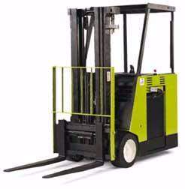
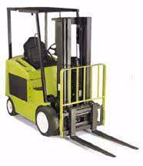
Class 1 Electric Truck
Types of Forklifts
Has the following:
Electric motor
A counter-weight in the rear
Solid or pneumatic (air filled) tires
Operator sits and drives
The "mast“ is the telescoping track on which the forks and load are raised and lowered.
Counter-weight and battery.
Forks on a forklift. Some trucks have a solid platform and are called "platform trucks”.
Solid tires for smooth surfaces. Pneumatic tires are used for rougher surfaces.
Notes:
These battery-operated electric forklifts are typically used in warehouses where lack of ventilation makes the use of propane, diesel or gasoline powered forklifts, a carbon monoxide hazard.

Slide 8
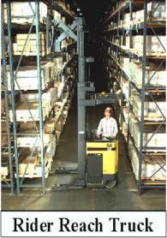
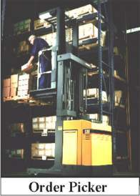
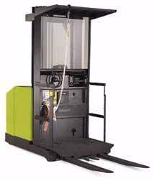
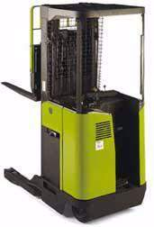
Class 2 Electric Truck
Types of Forklifts
Characteristics:
1. Electric motor
2. Narrow construction to fit in aisles
3. Solid tires
On some models, forks reach in and out as well as up, down and tilt. Other models have the forks on the side (called "Side Loaders“ ) or allow the forks to pivot to the side (called "Front/Side Loaders”).
The operator stands on a platform which moves up and down. Sometimes called an “order picker”
Straddle legs add stability for forklifts that don't use a counter-weight
Notes:
These specialized electric forklifts are used primarily in warehouses with high stacks of stored goods.

Slide 9
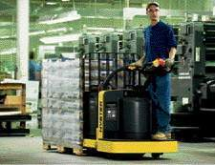
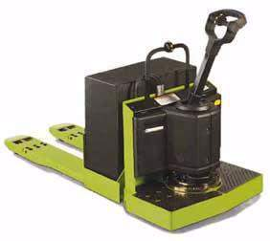
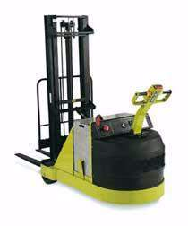
Class 3 Hand Truck
Types of Forklifts
Electric Motor Hand or Hand/Rider Trucks
Characteristics:
1. Motorized
2. Walk behind or ride
3. Low or high lift
4. Counter-weight or straddle
This motorized pallet jack has a counter-weight. Straddle legs are provided on more compact or reach models.
The operator can walk behind or stand on the platform and hold onto the grab bar.
Notes:
These electric vehicles are sometimes called walkie-riders and are typically used in warehouses.

Slide 10
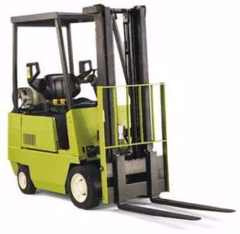
Class 4 Truck
Types of Forklifts
Characteristics:
Propane internal combustion engine
Solid tires
One of the most common types
Propane/liquid petroleum gas (LPG) fuel cylinder. Other forklifts run on diesel or gasoline.
Notes:
This propane-powered forklift is one the most common types of forklifts in use.

Slide 11
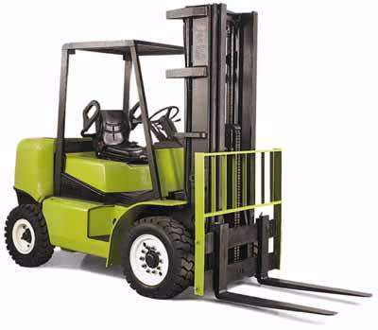
Class 5 Truck
Types of Forklifts
Characteristics:
Gasoline, diesel or propane engines
Pneumatic tires
Used outdoors in many cases.
Pneumatic (air filled) tires with tread are used for traction and stability on rough or wet surfaces.
Notes:
This is another common type of forklift often used outdoors.

Slide 12
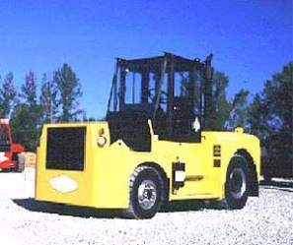
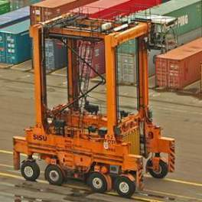
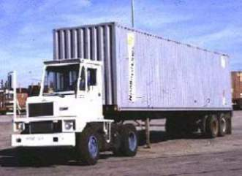
Class 6 Industrial Tractor Truck
Types of Forklifts
Characteristics:
Electric or internal combustion engine
Solid or pneumatic tires
Specialty vehicles
Pull or carry loads (no forks)
Wikimedia Commons
Yard Tractor
Wikimedia Commons
Wikimedia Commons
Industrial Tractor
Straddle carrier
Notes:
These specialty PITs will not be covered in this training.

Slide 13
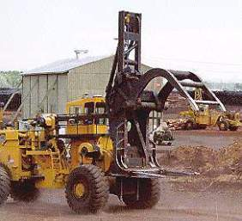
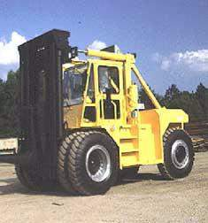
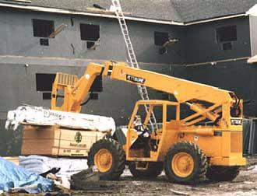
Class 7 Rough Terrain Truck
Types of Forklifts
Characteristics:
Used outdoors in uneven or muddy locations
Pneumatic tires
Gasoline or diesel-powered
Log Yard Forklift
Rough Terrain Reach Forklift
Rough Terrain Mast Forklift
Notes:
These heavy duty vehicles will not be covered specifically, but most of the information in this course would apply to them as well.

Slide 14
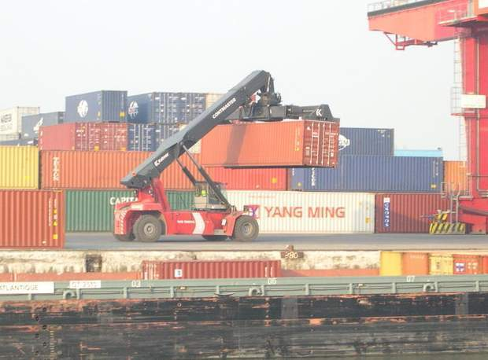
Types of Forklifts
Ship Container PITs
Wikimedia Commons
Notes:
This training will not cover these specialized PITs in detail. Even though these vehicles are much larger than standard forklifts, their safe operation are governed by the same general principles.

Slide 15
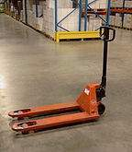
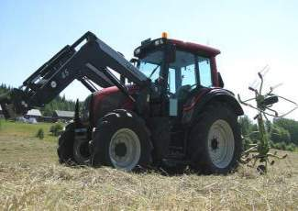
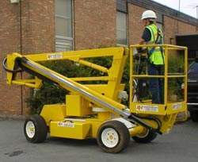
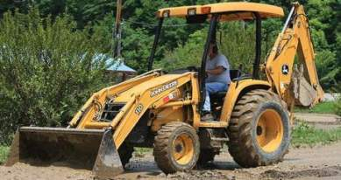
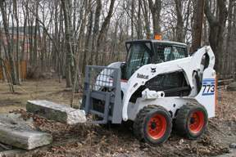
These are not powered industrial trucks (forklifts).
Types of Forklifts
Farm vehicles
Self-propelled elevated work platform
Non-powered pallet jack
Bobcat skid steer with forks
Earth-moving vehicle
All photos – Wikimedia Commons
Notes:
Sometimes these examples are confused with PITs since they can be used to perform similar tasks.

Slide 16
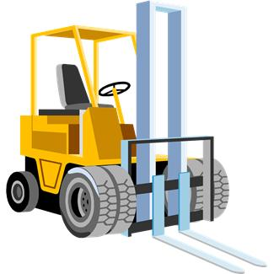
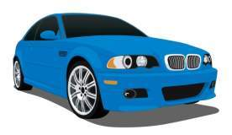
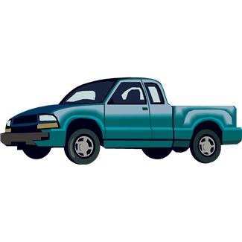
How is a forklift different from a car or truck?
Usually steers from the rear, rather than the front, making it swing wide
Carries heavy loads, often in tight places and rough terrain
Can have reduced visibility
Can have a high center of gravity making it susceptible to turnover
Controls are different and more complicated
Heavier than most cars and trucks
This…..
…..doesn’t operate like these.
Notes:
While the average automobile weighs around 3,000 pounds, the average forklift weighs around 9,000 pounds. Also, forklifts are heavier in the rear to counter the weight of items being carried in the forks. And, while cars have brakes on all four wheels, most forklifts only have stopping power in their front drive wheels. For that reason, forklifts are harder to stop, so they should be driven slowly.

Slide 17
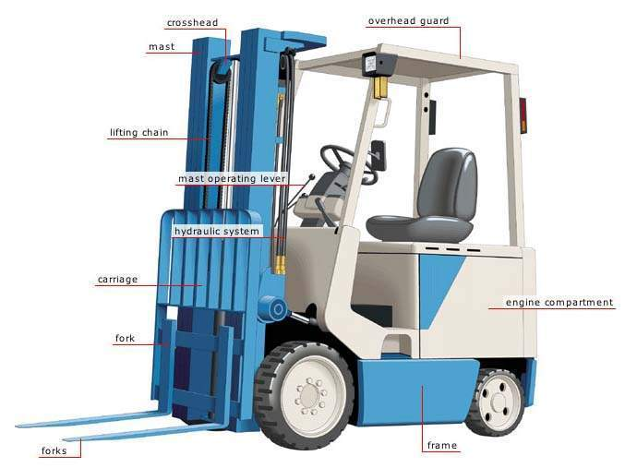
Parts of a Forklifts
Wikimedia commons
Notes:
This photo show the parts of a standard forklift. Other types will vary. All use hydraulic fluid to operate the forks. Most have a large counterweight in the rear to help balance a load on the front. Most have an overhead guard to protect the operator from falling objects. The main lifting work of the forklift is done with the forks and the mast, powered by the motor. Sometimes, older forklifts will develop a leak of hydraulic fluid. Without sufficient hydraulic fluid the forks will not operate properly, especially with a load. And a puddle of hydraulic fluid on a cement floor is a slipping hazard.

Slide 18
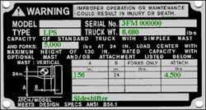
Forklift Nameplate
The nameplate will list the type of forklift and the capacity
Weight
Type
Load
capacity
OSHA
This forklift is a propane (LP) powered forklift, weighing 8680 lbs. with a lifting capacity of up to 4500 lbs.
Notes:
The nameplate gives important information about the capacity of the forklift. These must be readable at all times so any one who operates the forklift will know it's capacity and to not overload it.

Slide 19
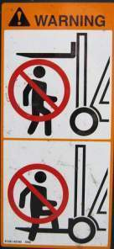
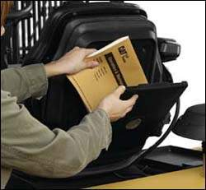
Forklift Operating Manual
Since there are numerous makes, models and types of forklifts, it is important to check for warnings in the specific forklift operator’s manual.
The manual should be kept on the forklift at all times.
Notes:
If several people will be using the same forklift, or there is frequent changes in forklift operators over time, keeping the operation manual on the forklift is really important.

Slide 20
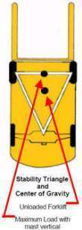
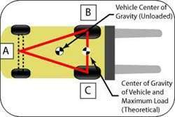
Forklift Stability Triangle
Almost all counterbalanced powered industrial trucks supported at three points. This is true even if the vehicle has four wheels. The truck's steer axle is attached to the truck by a pivot pin in the axle's center. When this point is connected to the front wheels with imaginary lines, this three-point support forms a triangle called the stability triangle. So long as the center of gravity remains within this stability triangle, the truck is stable and will not tip over.
Notes:
The stability of a forklift is important when you are handling heavy loads. The stability triangle is a way of describing how to keep the forklift stable and prevent it from tipping over with a heavy load. The next slide illustrates this idea further.

Slide 21
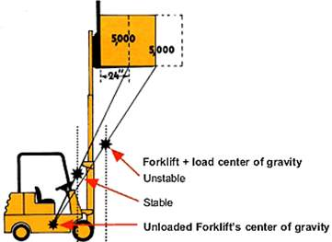
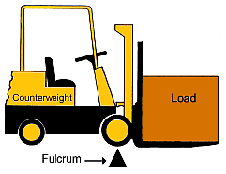
How loads affect forklifts
A forklift balances a load with a counterweight at the back. The front wheels act as a fulcrum or balance point. The center of gravity moves upward when the forks are raised.
Notes:
As the load is raised up and away, the center of gravity also shifts up and away from middle of the forklift. If it moves outside the triangle formed by the front wheels and the center of the rear axle, the forklift will tip forward or fall to the side.

Slide 22
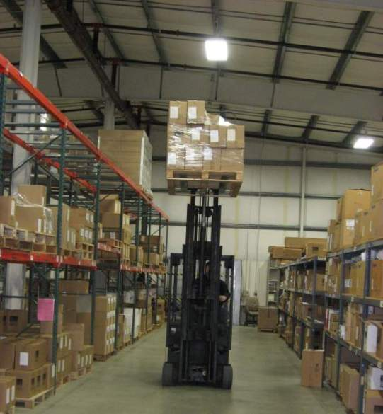
Don’t travel with a raised load!
Notes:
A forklift with a raised load tends to be very unstable, especially with a load near the forklift’s lifting capacity. So as soon as the load is picked off the upper shelf in this photo, the load should be lowered before traveling or moving forward or backward.

Slide 23
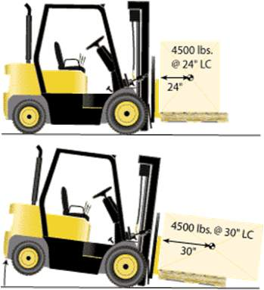
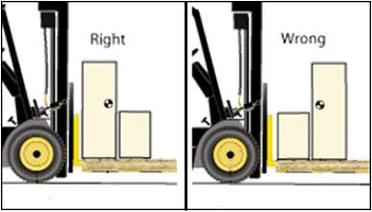
Forklift Load Capacity
Right
Wrong
While carrying a load near the maximum allowable capacity, be aware of the following:
Danger of tip over
Danger of losing load
Danger of being struck by falling load
Notes:
As you can see from these illustrations, the center of gravity of the load should be as close to the forklift wheels and mast as possible.

Slide 24
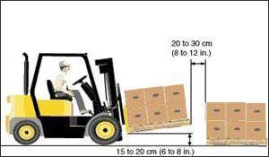
Moving the load
Use extra caution when handling loads that approach the truck's maximum rated capacity:
Tilt the mast & forks back and position the heaviest part of the load against the carriage.
Travel with the mast tilted back to keep the load stable. Never travel with the load tilted forward. Tilting the load forward increases the load distance and makes the load less stable.
Notes:
In addition to the points on this slide, you should not pick up a load with just the tip or front part of the forks. Place the forks all the way under the load and then tip it back slightly. You may need to tilt the forks forward slightly to get under the load and later to deposit the load. But at all other times the forks need to be tilted back.

Slide 25
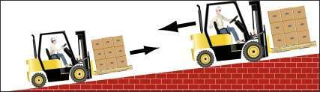
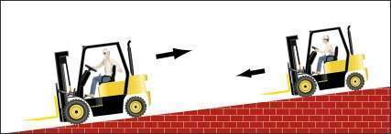
Driving on an incline
Always drive with the load on the uphill side - go backwards driving down the incline and frontwards going up the incline to prevent tipping or losing control of the forklift.
If no load on the forklifts, do the opposite with forks pointing down the ramp.
Notes:
When you drive on an incline with a load, always have the load on the uphill side. L & I rules requires these procedures be followed if the incline is 10% or more. In addition, its especially important to tilt the load backward and keep it low. Raise the forks just enough to clear the surface.

Slide 26
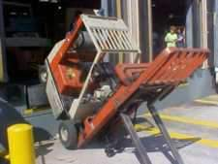
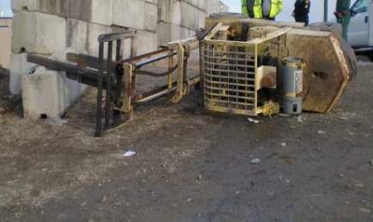
More reasons why forklifts tip over
Driving too fast around a corner
Driving off edge of platform, ramp, road or other surface
Driving an indoor forklift outdoors on rough, uneven ground outdoors
Operating on an incline or hill
Source: RiteHite Doors
Notes:
Forklifts can turn over for all the reasons shown on this slide.

Slide 27
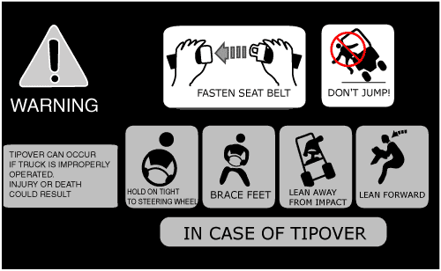
What do in case of a forklift tip-over
If the forklift tips, keep your arms and legs inside and hold on to the steering wheel. Don’t attempt to jump out – you can’t move faster than the forklift can tip over. Most people who attempt to jump are killed by the impact of the overhead guard.
Tipover procedures for other types of forklifts may vary. For example operators of stand-up forklifts with rear-entry access should step backwards off the forklift if a tipover occurs.
Notes:
In the case of a tipover, whatever you do – don't jump. Hold on and lean away from the direction of the fall. You may be shook up and banged up a bit, but you will survive.

Slide 28



Forklifts and Seatbelts
Seatbelts are required on all forklifts manufactured since 1992 and can be retrofitted on all older models.
You are required to uses it when it is supplied with the forklift. It will save your life.
Click it - before you drive!!
worksafeVictoria
A common cause of forklift fatalities is from the operator not having or using a seatbelt.
Notes:
Forklift fatalities have occurred when the operator was either thrown out of the forklift or they tried to jump out when the forklift overturned. Seat belts prevent that.

Slide 29
Forklift video clips from Worksafe B.C.
STAY IN THE CAB, STAY ALIVE
FIELDS OF VISION: PEDESTRIAN SAFETY AROUND FORKLIFTS
Notes:
The links to video clips is from Worksafe B.C. – the safety and health agency in British Columbia, Canada. The first covers the consequences of jumping from a forklift that is tipping over. The second one covers the real danger to pedestrians working in the same area as forklifts.

Slide 30


Forklift inspection and maintenance
All forklifts be examined at least daily before being used. Forklifts used on a round-the-clock basis must be examined after each shift. Check the following:
Fluid levels -- oil, water, and hydraulic fluid.
Leaks, cracks or other visible defect in hydraulic hoses and mast chains.
Tire pressure and tire cuts or gouges.
Condition of the forks, including the top clip retaining pin.
Safety decals and nameplates in place and legible.
All safety devices working properly including the seat belt.
U.S. Army
A vehicle that is damaged, defective or otherwise unsafe must be removed from service. Report the problem to your supervisor immediately.
MSHA
Notes:
If your company has no assigned person to do forklift inspection and maintenance, the responsibility is yours. You should double check even if the company has maintenance personnel. If you operate a propane powered forklift indoors, check for noticeable propane or exhaust odors which mean an engine tuneup is required to keep carbon monoxide levels low. More about that in the slides following.

Slide 31


Refueling a propane powered forklift
Liquid propane is extremely cold when released to the atmosphere. If your skin is exposed to propane while refueling, you can get frostbite.
Shut off the engine before refueling.
Don’t leave propane-powered forklifts near high heat sources. When parking propane-powered forklifts for a long period of time, turn the tank valve off.
Any propane leak must be taken seriously. Propane vapor is heavier than air and will tend to sink to the lowest lying area. If not adequately dissipated, it will ignite when exposed to a spark or flame.
Notes:
Propane is safe to use as long as it is contained. However, as this slide indicates, a large leak is a major hazard that could result in a fireball with severe burns to you or nearby workers. Some companies may have a propane cylinder exchange system where a propane vendor supplies full cylinders in exchange for empty ones. If you switch out empty cylinders with full ones, just remember to make sure all valves on the cylinders are closed.

Slide 32


Charging or changing batteries on electric forklifts
The battery changing/charging area should have the following:
No smoking signs.
Adequate fire protection.
Plenty of water for flushing and neutralizing spilled battery acid.
An eyewash that provides at least 15 minutes of flowing water enough ventilation to remove hydrogen gas during battery charging.
If you have to add water to batteries or handle battery acid, be sure to wear personal protective equipment.
Notes:
If you have to change or charge batteries on your electric forklift, you could be exposed to the hazards of burns from battery acid or fire from hydrogen gas. Because of their weight, batteries are typically lifted with a hydraulic hoist. If you are the one that has to do that, be sure you know how to operate the hoist correctly.

Slide 33



Forklift Attachments
Forklifts can have a variety of attachments which affect their performance and use.
The load capacity of the forklift is reduced by the weight of the attachment.
The attachment must be approved by the forklift manufacturer.
Crane Attachment
Drum Grabber Attachment
Be sure you know how to use the specific attachment on the forklift you will be operating or get training if you don’t.
Carpet Lifting Attachment
Notes:
Using an unapproved attachment can alter the forklift's lifting and balance characteristics and lead to the forklift overturning. The forklift must be marked in some way to show the weight of the attachment. This is usually found on the nameplate, unless it has been altered by a user without consulting the manufacturer. Doing so is actually a violation of forklift safety regulations.

Slide 34






Stacking loads on pallets
IRREGULAR STACKING PATTERNS
Wood strips, plywood or heavy cardboard between layers can help stabilize castings, bags, and other irregular shapes.
BLOCK
The most common. The upper level may be unstable if not encircled with wire or strapping.
BRICK
Containers are interlocked by turning each level 90 degrees.
PINWHEEL
Used where brick pattern is unstable.
Loose loads are subject to falling. Off center loads can also be subject to falling or cause the forklift to tip over. The illustrations above show the correct way to load pallets.
Avoid using damaged pallets.
Notes:
Pallet loads are often shrink-wrapped or otherwise secured with strapping or other devices, especially in warehouses. But sometimes one-time or short-term jobs or other work conditions make that impossible. In those cases, proper stacking on a pallet is important. In addition, damaged pallets are subject to collapsing suddenly and the load being dumped or dropped.

Slide 35



Forklift Work Platforms
Never lift other workers on forks unless you use an approved work platform with railings as shown.
U.S. Army
Source: Pelsue Co.
Dangerous!!
Safe
Notes:
Lifting someone on the forks of forklift is an extremely risky operation and often done “just for a minute” to accomplish some quick task. Don't allow yourself to be talked into it or think you can get away with it.
When a work platform is used, the forklift operator must always be in attendance – no further than 25 feet away, with the brake set. If the platform needs to be moved more than a few inches, the worker on the platform must get off first. No driving along with workers in the platform.

Slide 36


An extremely dangerous practice
A risky way to change a light bulb!!
Source: JICOSH
Notes:
Sometimes people will try to use a forklift with a stack of pallets on the forks to gain access to something out of reach. Don’t be a part of this practice, since the worker on the pallet can easily fall off.

Slide 37


Order Picker Fall Protection
In warehouses “order picker” forklifts, the vehicle must have either:
Standard guardrails on all open sides
or
A safety harness and lanyard
OSHA
CDC
Notes:
Order picker forklifts used in warehouses where the worker stands on the platform that raises and lowers presents a fall hazard. Workers who use this type of equipment must be protected by either a guard rail or the appropriate fall protection harness as shown. Waist-only harnesses, also called “body belts”, are not acceptable unless they completely prevent the operator from falling off the order-picker.

Slide 38


Why a safety harness is needed on an order picker forklift
While working in a warehouse using an order picking forklift, a worker tried to stand on a shelf to adjust the position of the load on the pallet. His foot slipped from the rack and he fell from the fourth tier to the floor.
Source: JICOSH
A safety harness would have stopped his fall.
Source: JICOSH
Notes:
This is an example of what can happen if a safety harness is not available or used.

Slide 39



Forklifts have reduced visibility
Both the forklift mast and a large load on the forks reduce forward visibility.
Older mast design
Newer mast design
In warehouses or other indoor workplaces, aisles of material, walls, doors and other building configurations can create blind corners.
OSHA – all photos
Notes:
Mast configuration can affect the operator's visibility. Newer mast designs use two side cylinders with a gap in the middle which provide much improved visibility compared to older mast designs that have a single central cylinder. But with a tall load, your forward view will be blocked, making it necessary to travel in reverse or use a spotter.

Slide 40

Forklift Blind Spot
Blind spot
Notes:
When moving forward, the mast will block part of your view, even when the load is lowered.

Slide 41


Forklifts and Pedestrians
Slow down and sound horn at intersections, corners, and wherever your vision is obstructed.
When provided, use flashing warning light or backup alarms when traveling in reverse.
Always look in the direction of travel.
Signal to pedestrians to stand clear.
Do not allow anyone to stand or walk under upraised forks.
When possible, make eye contact with pedestrians or other forklift operators before moving in their path.
OSHA
Notes:
Your employer may have restricted lanes for other workers – pedestrians – but people don’t always pay attention. You are often moving faster than a pedestrian and forklifts can’t stop suddenly, especially with a load. 10% of all fatalities involving forklifts are from workers being struck or run-over by a forklift. Don’t let it be your fault.

Slide 42


Forklift-pedestrian accident example
Source - JICOSH
Source - JICOSH
Neither the pedestrian or the forklift operator were paying attention!!
Notes:
In this example of a real accident, the pedestrian walked behind the forklift without catching the attention of forklift operator even though the back-up alarm was sounding. The forklift operator failed to look backwards, so the forklift hit the pedestrian, knocked him down and badly injuring his leg.

Slide 43




Loading truck trailers and railroad cars
Make sure:
Truck trailer wheels are chocked
Dock board is secure and can handle weight
You use horn or warning lights when exiting trailer or railcar.
OSHA
OSHA
Notes:
Driving in and out of a trailer or railcar can cause either the ramp or the trailer itself to move. Securing truck trailer wheels prevents trailer movement and keeps dockboard secure. Dockboards or bridgeplates have various methods or attachments to keep them secure.

Slide 44


Wide or irregular size loads
Source - New York Dept. of Health
OSHA
Distribute the weight evenly when carrying irregular sized loads.
Keep the center of gravity of the load as near as possible to the center going horizontally across the forks.
Keep the center of gravity of the load as near to the front wheels as possible.
Notes:
Wide loads are susceptible to shifting or sliding off the forks and of course make it difficult to maneuver in tight places. Irregular size loads can shift the center of gravity in unexpected ways. Caution in handling these types of loads is necessary. It is often safer to move a wide heavy load with a crane rather than a forklift.

Slide 45


Loading/unloading High Storage Racks
When removing a load from a high rack:
Slowly back out with the load
Stop when it clears the rack
Lower the load to the floor
Don’t lower the load while moving!
Notes:
In warehouses with high storage racks, the lightest loads should be placed on the top racks, and the heavier loads on the bottom racks. Remember a forklift is less stable with a load raised high, especially while moving.

Slide 46


Forklift Do’s and Don'ts
No one else on the forklift except the operator, unless the forklift has a seat for a rider.
Always drive with the forks lowered and lower forks to floor when parking the forklift.
Source: JICOSH
Watch overhead clearances – especially entering or exiting buildings or when you are raising a load on the forks.
Source: JICOSH
Click here for Yale forklift company safety poster
Notes:
The link to the Yale forklift company poster at the bottom of the slide is a good list of forklift safety practices. It can be simply viewed or printed out.

Slide 47


The risk to a rider on a forklift
A seasoned forklift operator sat next to the operator's seat while showing a new operator how to operate the forklift.
Source: JICOSH
The new operator accidentally performed the wrong maneuver, causing the forklift to run into one of the pillars at the site. The worker who had been training him was crushed between the support pillar and the forklift.
Source: JICOSH
Notes:
This example shows one reason why riders on a forklift is dangerous. The other reason would be that the rider could easily slip off the forklift since he has no seatbelt and is not sitting in a seat.

Slide 48


Stay out of the mast of a forklift !!
While using a forklift to transport 15 cardboard boxes at once, some of the boxes started to slip. The operator climbed into the mast to adjust the falling boxes.
Source: JICOSH
When the worker stepped between the operator's seat and the mast (without turning off the engine first) he accidentally hit one of the control levers, causing the mast to move. He was crushed between it and the overhead guard.
Source: JICOSH
Notes:
This is another example of an actual accident. The safer way this operator should have handled this situation was to slowly lower the load to the ground, set the brake and then dismounted the forklift and re-adjusted the boxes.

Slide 49

No Speeding!!
Wikimedia commons
Notes:
It goes without saying – just like any other moving vehicle, watch your speed. It's especially dangerous in a workplace with nearby workers and walls, doors, racks or stored material that block your view. As mentioned before, it's harder to stop a heavy forklift with a load than a car, even at low speeds.

Slide 50

Don’t leave your forklift unattended
A forklift is considered "unattended" When the operator is 25 ft. or more away from the vehicle even if it remains in his view, or whenever the operator leaves the vehicle and it is not in his view.
When a forklift is left unattended, forks must be fully lowered, controls neutralized, power shut off, and brakes set. Wheels must be blocked if the truck is parked on an incline.
Wisconsin Dept of Health Services
Where’s the operator??
When the operator of a forklift is within 25 ft. of the truck still in his view, the load engaging means must be fully lowered, controls neutralized, and the brakes set to prevent movement, but the power does not need to be shut off.
Notes:
Not leaving an operating forklift unattended is another requirement of the L & I safety regulations on forklifts.

Slide 51

Propane-powered forklifts and carbon monoxide
Propane powered forklifts produce carbon monoxide. The amount depends on how well they are tuned, but should be 1% or less at the tailpile.
Source:Worksafe BC
Carbon monoxide poisoning can occur when propane forklifts are used in cold rooms, controlled atmosphere rooms, truck trailers or shipping containers, or in warehouses or other enclosed areas that do not have enough fresh air ventilation. If propane powered forklifts are used indoors, they should be tuned up regularly and tested for carbon monoxide emissions periodically.
Click here for more information on carbon monoxide and forklifts
Notes:
You may have heard or been told that propane powered forklifts “burn clean” or don’t emit carbon monoxide. Although the amount is much less than a gasoline engine, they still do produce carbon monoxide and the levels can be quite high on poorly tuned forklifts. In fact carbon monoxide poisoning from indoor forklift operations is a common occurrence in Washington state, especially in the fall or winter when warehouse doors are closed up or ventilation is turned off or malfunctions. Symptoms of carbon monoxide poisoning are typically a severe headache, nausea or even collapse in worst cases.
As you might expect, carbon monoxide poisoning is an even greater hazard with gasoline powered forklifts and diesel powered forklifts as well, in confined or unventilated areas.

Slide 52


You must also have hands-on training on the specific truck you will operating
Safe Operation of Forklifts and Other Powered Industrial Trucks
... truck controls and handling are different
Click here to see L & I forklift operator training requirements
Notes:
Your training is not complete with this online course. This is just the beginning to give you some general information on forklifts, how they work and the hazard associated with operating them. You also need supervised hands-on training with the specific forklift you will be using. This is required by L & I regulations as well as making common sense.
An 8 question quiz follows this slide. To show that you have completed this course, you must answer all the questions in the quiz, and print out the quiz results with your name. Click the submit button after you select your answer to each question. You get two tries on each question and a passing score is 75% or 6 or more correct answers. The printed results of the quiz will be your document that you have taken this course. You do not need a special printed certificate to operate a forklift, just the appropriate training.

Slide 53
Safe Operation of Forklifts and Other Powered Industrial Trucks
Forklift Safety Quiz Questions

Slide 54
Quiz
1. Because a forklift weighs more, it is easier to stop it with the brakes than a car.
True
False
Notes:
Correct answer is “false”.

Slide 55
Quiz
2. When driving down an incline with a loaded forklift, you should:
Go down the incline backwards.
Raise the load before going down the incline.
Go down the incline frontwards.
Honk the horn.
Notes:
Correct answer is “go down the incline backwards”

Slide 56
Quiz
3. If you are driving a forklift and it hits a hole and starts to turnover, you should:
Jump out away from the direction it's falling.
Quickly turn off the engine.
Pull your arms in and hold on.
Crank the wheels the opposite way it's falling.
Notes:
The correct answer is “pull your arms in and hold on”

Slide 57
Quiz
4. If you see a large puddle of hydraulic fluid under the forklift, the first thing you should do is:
Use it to finish your task and then take it to maintenance.
Clean up the puddle before someone slips on it.
Inform maintenance or your supervisor and not operate the forklift.
Find out where the leak is coming from.
Notes:
The correct answer is “inform maintenance or your supervisor and not operate the forklift.”

Slide 58
Quiz
5. Before you first enter a truck trailer with a forklift you should:
Check to make sure the trailer has been secured with wheel chocks
See if there is a spotter inside the trailer.
Get your supervisor's approval to enter.
Jump up and down on the dock board.
Notes:
The correct answer is “check to make sure the trailer has been secured with wheel chocks.”

Slide 59
Quiz
6. Special attachments to a forklift can be used when:
The production manager approves it.
The forklift manufacturer approves it.
You have checked that it doesn‘t change the forklift operation.
None of these.
Notes:
The correct answer is “the forklift manufacturer approves it”.

Slide 60
Quiz
7. The best way to handle a large load that reduces visibility is to:
Honk the horn continuously so other workers know you are moving.
b) Drive in reverse or use a spotter.
c) Raise the load so you can see under it.
d) Walk the route first so you know where to go.
Notes:
The correct answer is “drive in reverse or use a spotter”.

Slide 61
Quiz
8. A propane powered forklifts doesn‘t cause a carbon monoxide hazard if:
It is well-tuned and there is plenty of ventilation.
It is driven slowly.
It is used in place of a gasoline-powered forklift.
It is a brand-new model.
Notes:
The correct answer is “it is well tuned and there is plenty of ventilation”.

