Slide 1
Substance Free Workplace
subtitle

Slide 2
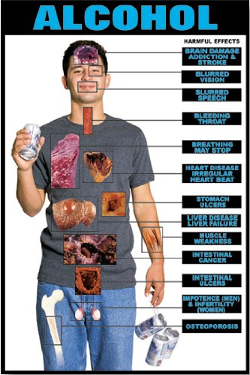
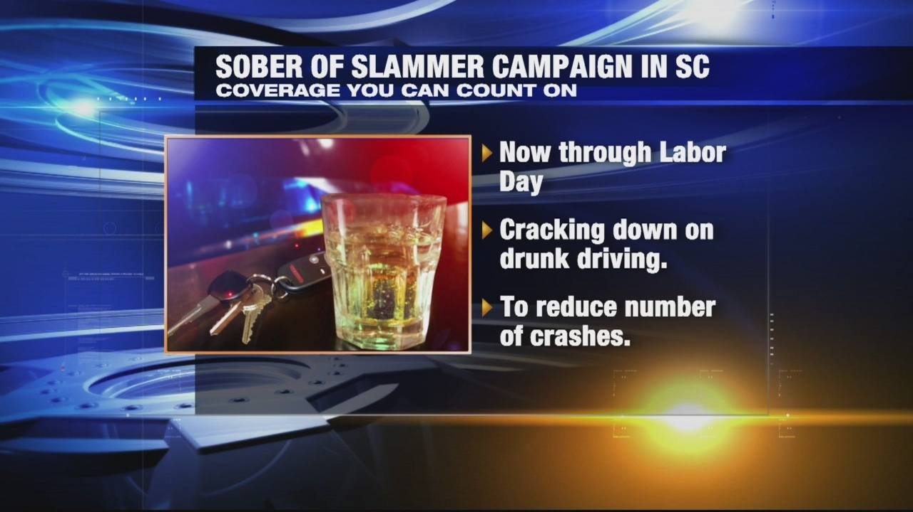
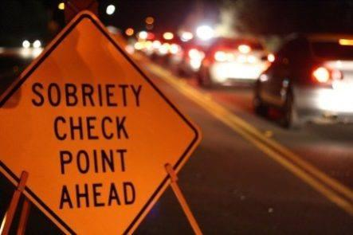

Slide 3
Cost of Excessive Drinking
$249 Billion in 2010
$2.05 / drink
72% of the cost affects losses workplace productivity
Health care expenses are 11% for treating problems
Law Enforcement and Criminal Justice expenses 10%
Losses form Motor Vehicle crashes account for 5%

Slide 6
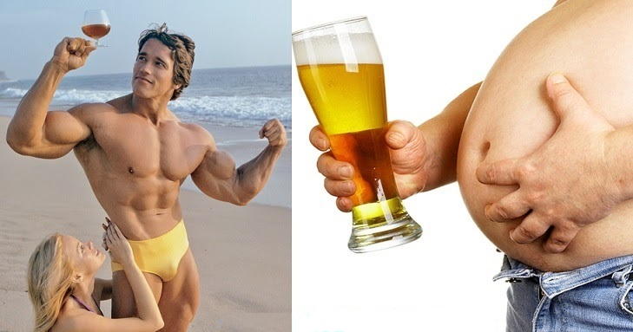
The effects…

Slide 7
Lesson to Learn…. By not making the mistake

Slide 8
You don’t know what you are poppping

Slide 9
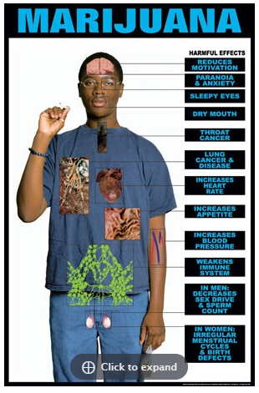
It affects YOU

Slide 10
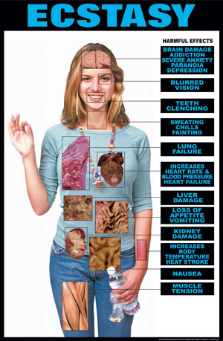
Don’t Pop ‘em

Slide 11
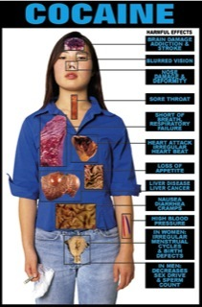
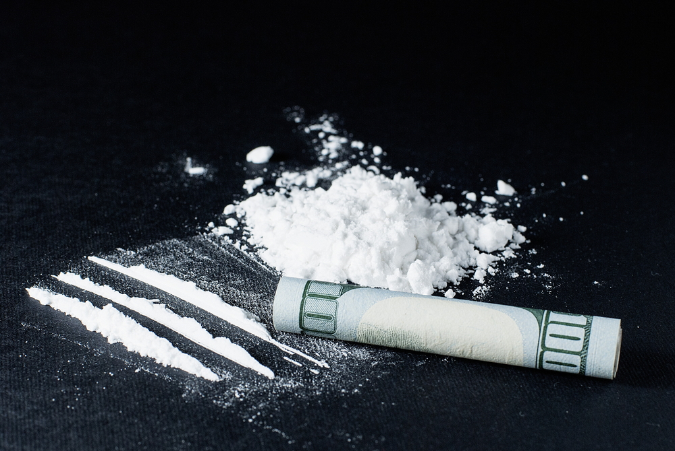
Nose Candy ?
Nose Candy ?

Slide 12
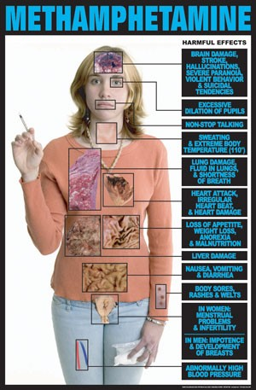
Don’t Meth with it…

Slide 13
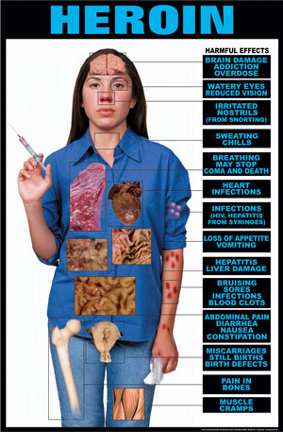
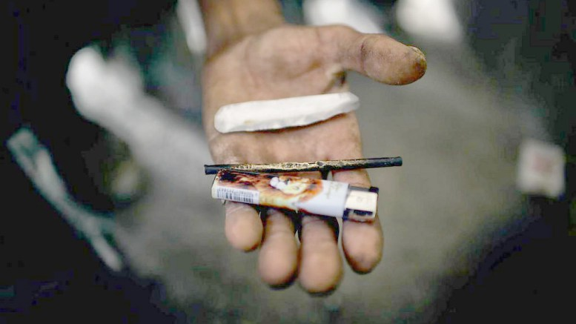
Don’t Pop ‘em

Slide 14
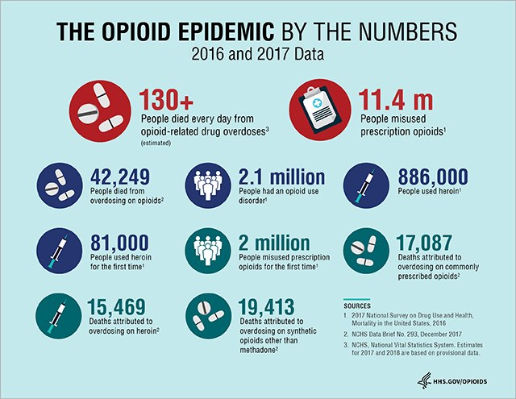
Pain Reliever ?? Pain Killer ?? Killer…..

Slide 15
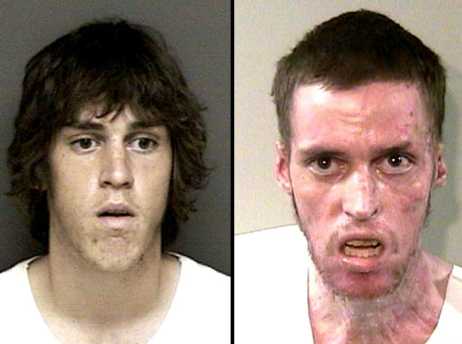
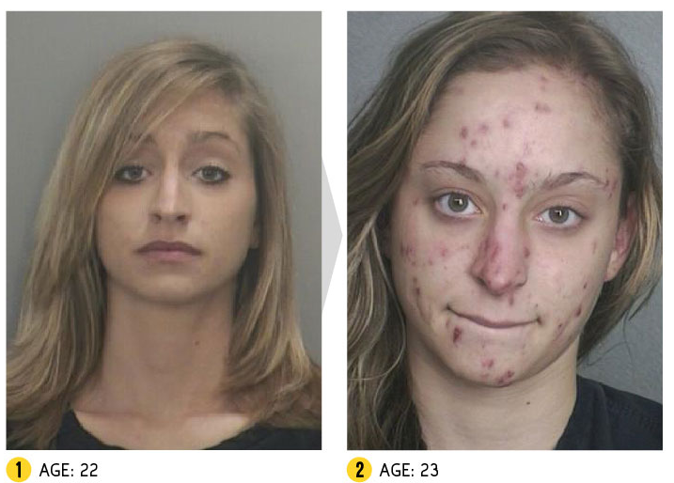
The effects…

Slide 16
Drug Overdose Death Rate
63,632 Drug overdose deaths in the US - 2016
Opioids – 42,249 ~ 66.4 %
SC : 15.3% increase in overdose deaths 2015 > 2016
Worst : W Virginia (52), Ohio (39), New Hampshire (39), Dist of Columbia (39), Pennsylvania (38) / 100,000

Slide 17
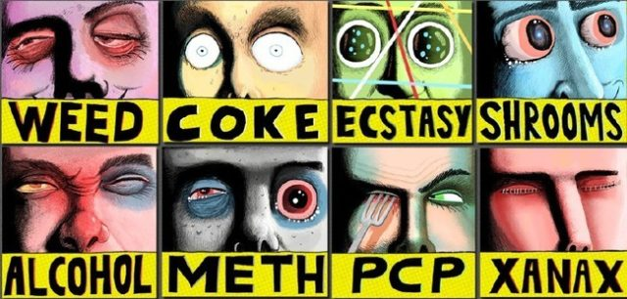
Drug Quiz….

